Slide 1
THE INTERNSHIP AND PORTFOLIO TOOLKIT
NUEVA SCHOOL FOR THE PERFORMING ARTS

Slide 2
NUEVA SCHOOL FOR THE PERFORMING ARTS

Slide 3
OUR PROGRAM
Nueva is a performing and managerial arts program at Windsor high school, in Windsor, California
We are one of seven focus area programs on the Windsor high campus
Nueva serves a diverse population of students
Our 10th grade academy is set up as an intervention program for at-risk students (60 students)
Our 11th and 12th grade academic classes provide students with an embedded honors option for English and Social Studies (augmentation) (90 students)

Slide 4
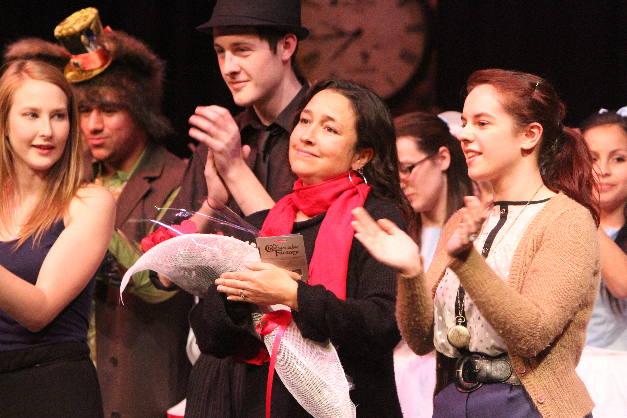
PRODUCTION UNITS: HANDS-ON LEARNING
11th and 12th grade students put together 2 productions each school year
School day is restructured
Students go to work at school
Production groups: set design/construction, marketing and promotion, costuming, lighting and sound, stage (dance, acting, music), gallery design, and management
Notes:
10th grade students participate in workshops during CPA class
Directors, actors, musicians and other professionals (mask-makers, color consultants, marketers, film-makers, etc)
-90 MINUTE ACADEMIC BLOCKS ARE REDUCED TO 65 MINUTES. ENTIRE 90 MINUTE BLOCK AFTER LUNCH IS DEDICATED TO PRODUCTION
-TEAM LEADERS ARE DESIGNATED, STUDENTS ARE ASSIGNED SPECIFIC TASKS, TIMELINES ARE GENERATED, AND ALL JOBS MUST BE COMPLETE BY DEADLINES.

Slide 5
THE VISION
Through production units and student internships, students will acquire skills that will prepare them for life after high school.
Emphasis on 21st Century skills
Creativity, Critical Thinking, Communication, Collaboration
Notes:
Internships can take many forms, some are more project based

Slide 6
TRANSFERRABLE SKILLS
Training in the tech crew has taught me to develop a well-rounded style to help visual, auditory, and kinesthetic learners. I proved to myself that I can teach others to perform a dangerous job safely.” - Lauren, Senior
“I have never been on stage, but when I come to our opening night and see our community cheering and laughing, it brings a smile I can’t shake off. Nueva has given me the confidence that inspires me to make a change and give back to my community.” - Daniel, Junior
“Nueva has helped me gain the confidence to speak in front of a big audience. Performing on stage and presenting in front of a panel made up of professionals taught me the importance of speaking and communication skills. Everything I learned will be useful in my life beyond high school.” - Nina, Senior

Slide 7
THE STUDENT INTERNSHIP
10 HOURS FOR 11TH GRADE STUDENTS
30 HOURS FOR 12TH GRADE STUDENTS

Slide 8
FINDING A MENTOR AND INTERNSHIP
Discuss internship requirements, guidelines and deadlines with students
Provide students with an ongoing list of community members and businesses willing to work with Nueva students
Teach students to write professional inquiry emails and follow-up protocol, write phone a call script and practice cold call
Notes:
Students must find their own placement…talk about success and failures
Career exploration begins in 10th grade through Kuder. Internship should be geared towards their interests
Performing, managerial, or visual arts

Slide 9
THE PROPOSAL
Each student must write an internship proposal and acquire mentor and advisor signatures
Describe your internship?
Why did you select this particular internship?
Who is your mentor, and what is his/her area of expertise
How to you plan on completing your hours?
Notes:
Advisors are academic teachers

Slide 10
THE MENTOR GUIDE
All mentors are invited to attend a meeting that outlines program requirements.
They are provided with a mentor guide and contact information for all program advisors
Mentors are emailed a check in survey
(Google forms) that help us monitor student progress

Slide 11
THE TIMECARD
Students must document their hours and obtain mentor signatures
Students must complete detailed reflective notes about their daily tasks
Students must provide evidence of completion
insert pictures in timecard
Attach brochures, flyers, handouts, or any other relevant documentation of internship
Notes:
All go into the student portfolio

Slide 12
THE REFLECTION
Reasons for Project Selection
Mentor Role
Detailed Description of the Process and Time Spent
Incidents of Challenge, Insight and Success
Personal Growth/Skills Acquired/Lessons Learned
Transferrable Skills Obtained and How:
Overall Conclusion

Slide 13
THE EVALUATION
Mentor evaluation document
Completion of portfolio and participation in mock interview and jury assessment
Complete a self-evaluation rubric (google forms)

Slide 14
The professional portfolio
Print and Digital

Slide 15
THE COMPONENTS
THE COVER LETTER
The cover letter is addressed to mentor in internship placement
The School to Career Toolkit (part of CPA course curriculum)
THE RESUME
A resume builder handout is kept with students at all
The The School to Career Toolkit
TWO LETTERS OF RECOMMENDATION
Students use recommendation request form
3 weeks to obtain letters
BUSINESS CARDS
Personalized logo
Professional email address
Digital portfolio website
Notes:
Students gain experience in CPA class (Adobe training on photo shop and in-design), production units, workshops with consultants, field trips and internships)
Head shot, unified graphics, and all internship documents included

Slide 16
THE DIGITAL PORTFOLIO

Slide 17
THE ASSESSMENT PROCESS
Print portfolios are reviewed and graded by academy teachers and at least 2 community or advisory board members
All Nueva Seniors must present in front of a panel of community members
Present digital portfolio and discuss internship
Demonstration or exhibition
Mock interview

Slide 18
“Being part of Nueva has prepared me for life after high school, particularly in providing me with the skills needed to acquire a job. In our recent play, I was thrown into the job of lighting board operator. Knowing nothing about theater lighting, I was extremely apprehensive. But, with support and training, I stepped up to the task and gained the confidence to do anything I set my mind to.” - Ceci, Senior

Slide 19
Using WEEBLY for website construction
Program Website: nuevaarts.org
Student websites: iranialopez.weebly.com
Promotional website: nuevastreetscene.weebly.com

Slide 20
WHAT IS AVAILABLE?
INTERNSHIP RESOURCES
SCHOOL TO CAREER TOOLKIT
The Mentor Guide
Internship Requirements
Internship Proposal Form
Internship Timecard Form
Internship Reflection Form
Internship Evaluation Form
Recommendation Request Form
Rubric for Jury and Portfolio Assessment
Resume Guide
Cover Letter Guide
Networking Guide
Job Interview Guide
Notes:
Downloadable resources which can be altered/modified to meet the needs of any CPA program

Slide 21
QUESTIONS

